Slide 1
Mathematical Sets
Hayley Richardson

Slide 2
What is a set?
A collection of distinct, related objects (numbers in math)
Examples:
{1,3,5,7,9}
{2,4,6,8,10}
Z
Q
{∅}

Slide 3
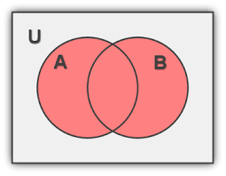
Set Operations: Union
Union: ∪
A ∪ B={x| x ∈ A ∨ x ∈ B}
Elements that are in either A or B

Slide 4
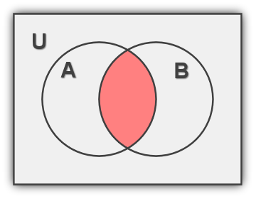
Set Operations: Intersection
Intersection: ∩
A ∩ B={x| x ∈ A ∧ x ∈ B}
Elements that are in both A and B

Slide 5
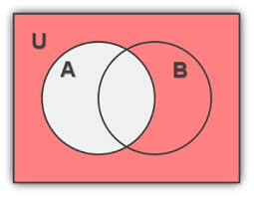
Set Operations: Complement
Complement: ‘
A’={x | x ∉ A}
Elements in the universe
that are not in A

Slide 6
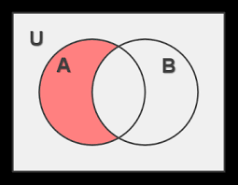
Set Operations: Difference
Difference: \
A\B={x ∈ A | x ∉ B}
Elements in A that are
not in B

Slide 7
Subsets and Supersets
A set is a subset of another set if all of its elements are contained within the other set (called a superset)
Expressed using ⊆, as in A ⊆ B (read “A is a subset of B”)
Example:
A={1, 3, 5}
B={1, 2, 3, 4, 5}
A ⊆ B
A is the subset; B is the superset

